Slide 1

Project Managers in the Software Engineering Classroom
Samuel Malachowsky
Rochester Institute of Technology - Software Engineering

Slide 2
Problem Statement
Coursework-centered Teams
Unbalanced Teams
Lots of Project and Process, but no Product
PM Role Undefined
Little Experience in PM-team exchanges
Repetitive, unengaged Final Presentations
“Lack of coordination, poor communication, misunderstanding roles”

Slide 3
Process and Project Management
Required by all Software Engineering Majors
Fundamentals of Engineering Process and Project Management
Project Functions
Software Engineering Models and Methodologies
Project Management Practices
Software Engineering Concepts
Becoming a better project leader (PM) or team member
Class Time: Lectures 50%, Group Activities 25%, Main Project 25%

Slide 4
The Main Project
Project
Creation and evaluation of Project Artifacts
Modified Project (+)
Give the students a chance to participate in a more realistic Project Management scenario
Add a non-artifact product
Increase engagement/variety in the final presentation
“I think this was the best group project I've ever been a part of. The PM was great at getting everyone to meetings, as well as assigning work to the various members of the group.”

Slide 5
PM’s In the Classroom
Appropriate Timing
After 1st midterm – 1/3 of the way through the class
Realistic Responsibilities
Differing Experiences
Most interactions are public
Each group sees 2 other groups’ artifacts
Team member/PM interactions
What is it like to work as/with a PM?
“I really like how the project managers volunteered for the position, because it meant that they were willing to put forth the effort to manage the group, and as a result I felt more motivated to participate as a member.”

Slide 6
Results
More Interest
In the project activity as well as Project Management
Better Balance
In schedule and team makeup
Increased Engagement
Teams feel and are treated as units
Final Presentations
Less repetition, more buy-in by presenters and audience
“I think the use of Project Managers really helped highlight the things we were learning in this class, at least that was the experience I had in my group. When you have a proactive PM who is good about getting people to show up to meetings and actually getting their work done, it becomes much easier to complete a project, and do it well.”

Slide 7
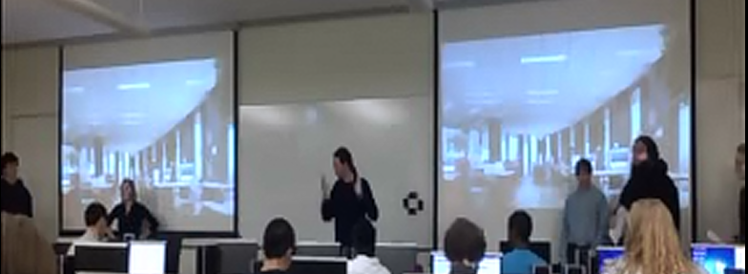
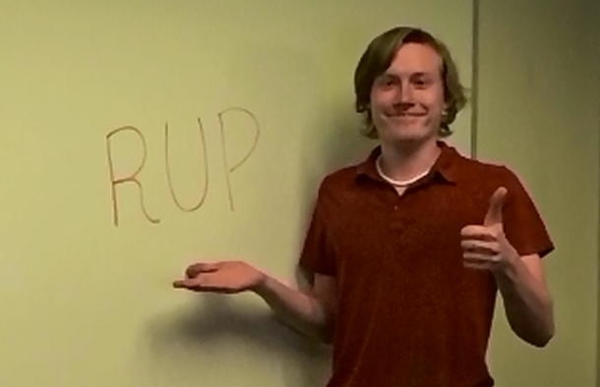
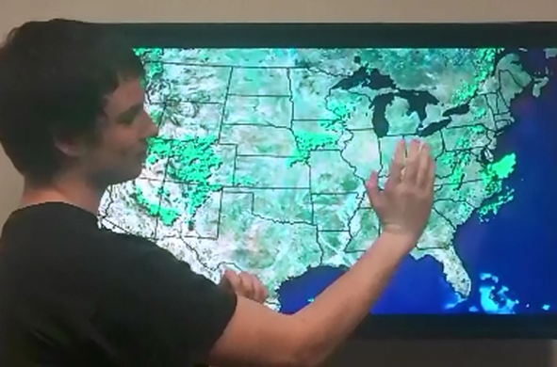
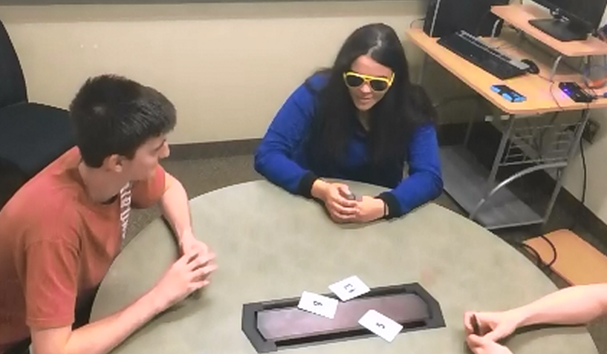
Results
Agile vs. Plan Driven “Smackdown”
Nova: The Magic of RUP
Project Risk Report
World Series of Planning Poker

Slide 8
Thanks… Questions?
Samuel A Malachowsky
Rochester Institute of Technology
Software Engineering
samvse@rit.edu
TeachingSE.com

